Slide 1
Dynamics of Ranking
Authors: Gerardo Iniguez, Carlos Pineda, Carlos Gershenson, and Albert-Laszlo Barabasi.
Presenter : Seth laurenceau

Slide 2
Motivation
Rankings are everywhere
Rankings are general
Rankings serve as a proxy for fitness

Slide 3
Common threads
Seems to follow Zipf's law
A wide range of systems follow this distribution

Slide 4
Hints of simplicity
So many systems with the same behavior
Implies a simple generative mechanism

Slide 5
Our data
30 ranking lists
natural, social, economic, and infrastructural systems
No selection criteria beyond having enough data
Vary wildly in size and timespan

Slide 6
Measures of a ranking list
o_{t} = N_{t}/N₀
F_{t} = probability of element change at time t

Slide 7
Patterns in measure

Slide 8
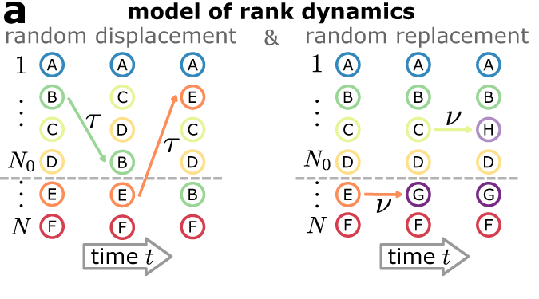
A simple model

Slide 9
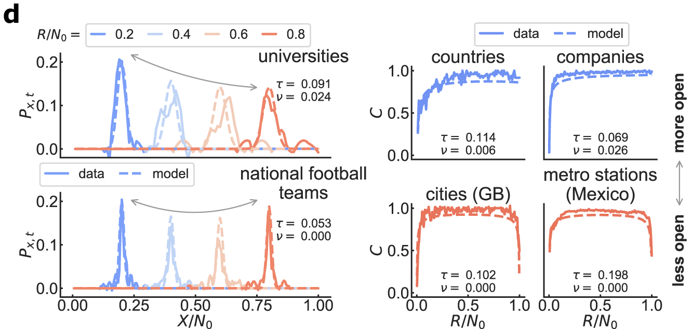
Solving the model

Slide 10
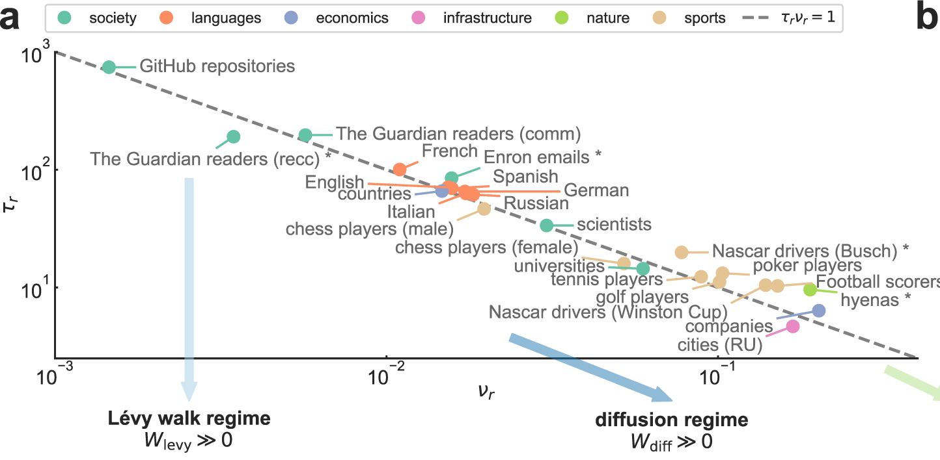
Takeaways

Slide 11
Evaluation
Foundation for analysis of ranking perspective
All data had "positive" rankings
The replacement regime is mysterious

Slide 12
Questions?

Slide 13
Thank You!

